Slide 1
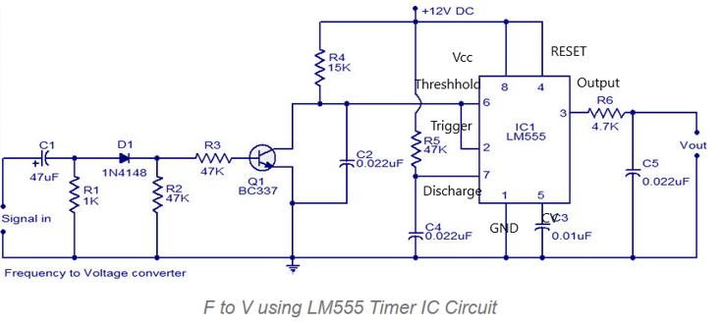

Slide 2
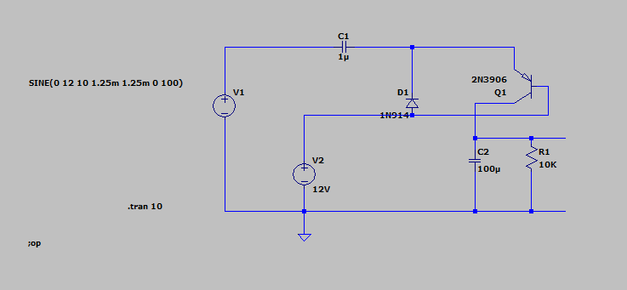

Slide 3
Frequency (kHz) | Output Voltage (V)
2 | 13.00-13.20
4 | 13.32-13.50
6 | 13.59-13.86
8 | 13.92-14.12
10 | 14.24-14.48
12 | 14.52-14.73
14 | 14.80-15.04
16 | 15.10-15.25
18 | 15.32-15.52

